Slide 1
Apache WebServer

Slide 2
Index
Apache Overview Diagram
Brief Background
Apache Architecture Overview
Apache Overview Diagram
What is a Web Server? And What is HTTP?
HTTP Request Processing
Multi-processing
Client-Server Interactions
Apache Core
Request Phases
Overview Of Modules
Concurrency in Apache
Security Perspective
Apache Installation
Directory Structure
Server Startup
Apache Configuration

Slide 3
Brief Background
Initially started in 1996 by Robert McCool.
Since 1996, Apache web server has been the most popular HTTP server in the market on the World Wide Web.
The Apache was the first web server architecture that was used by the Netscape Communication Corporation.
Apache has evolved with the years of the internet. Server is used to support both static and dynamic pages online. Many programming languages are supported by the Apache Server are as follows: PHP, Perl, Python and alongside with MySql.
As of April 2008, the Apache Server serves approximately 50% of the current web pages.

Slide 4
Apache Architecture Overview
Apache is a open source HTTP web server. It handles HTTP Requests sent to it and then it is able to respond to them.
Apache is Open source and is built and maintained over at Apache.org
Apache is comprised of Two main building Blocks with the Latter being comprised of many other little building blocks. The Building Blocks are the Apache Core and then the Apache Modules that in a sense extend the Apache core. More detail on this on next couple of slides.
Very easy to implement and very easy to add extend its abilities by the adding of different modules. This is why this server has become so popular.

Slide 5
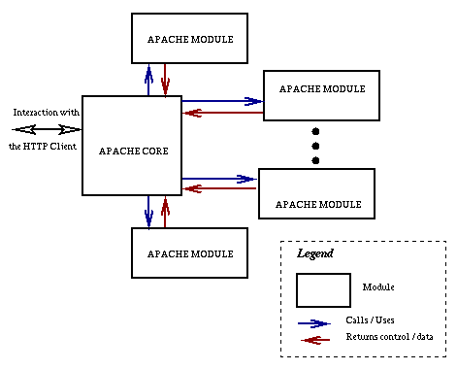
Apache Overview Diagram
As you can see the designers of Apache decided to take a modular approach so that anyone can add to the basic functionality of the server without disturbing the basic Core implementation.

Slide 6
What is a Web Server? And What is HTTP?
A Web Server is any Machine that receives requests from a client machine and is able to turn around process the requests and send back a response. This is usually in terms of a Web Server to send back a Web pages when people what to go navigate to a webpage that is hosted on that server now one may ask how do you send and receive the information to and from the server. This is where HTTP begins to play a role into how this all goes about.
HTTP Protocol: HTTP stands for Hyper-Text-Transfer-Protocol
This is the protocol that is used in order to send and receive information from the server. This is the protocol that the Apache Web Server Understands and it is what it uses to send information back to the client Machine.
If you would want to get a bit more technical on the subject the Client Machine in this case the Browser sends a HTTP.Request Object to the Server then the Server responds back by using an HTTP.Response Object. This is the general back and forth between the server and the browser. Apache is made to handle all of these requests.

Slide 7
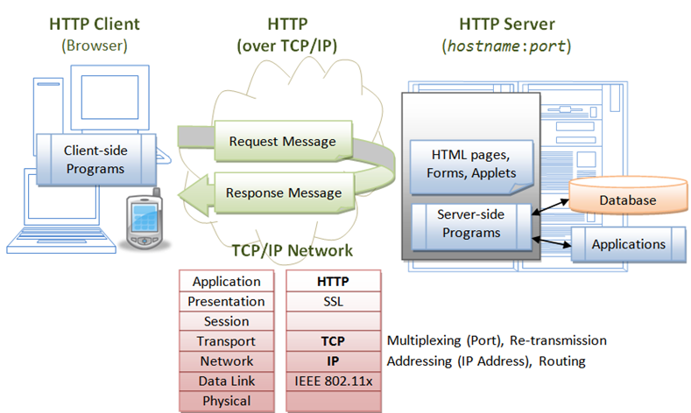
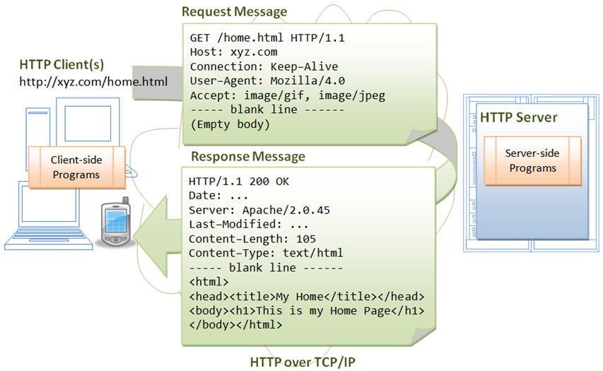
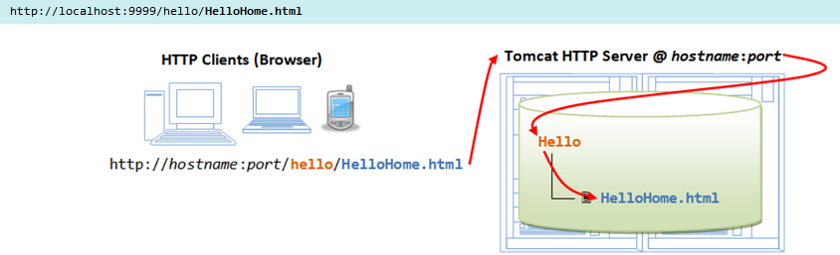
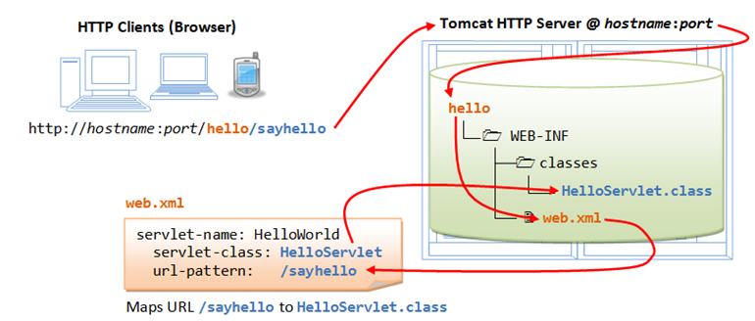
HTTP Request Processing

Slide 8
Multi-processing
Multithreaded and Multi-processed Web Servers
When an HTTP request arrives, the Web server starts fetching the resource as requested by the client. While the Web server is busy fetching resources, the client computers might send more requests. This total of requests are needed for processing. These requests are either ignored or handled simultaneously by the Web server.
Web servers that ignore other requests or they will even queue them while the servers are busy. This process is called single-threaded Web servers. This means that they are incapable of handling high Web server traffic. However, these types of Web servers are ideal for Web sites that encounter low or moderate traffic.
Web servers that can handle simultaneous requests, manage the requests in two ways. Either they start a new process or they start a new thread within a process. Web servers that start a new process on each request are called multi-processed Web servers, while those that start a new thread within the main process are called multithreaded Web servers. The is a slight difference among those terminology.
IIS (Internet Information Services) on the Windows platform is an example of a multithreaded Web server. Apache on a Unix platform is a multi-processed Web server.

Slide 9
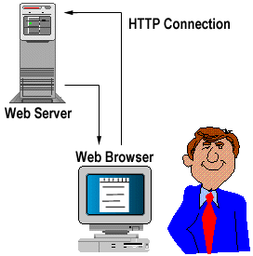
Client-Server Interactions
As we stated before the Client makes an HTTP request to the server in this case the Apache Web server then the server handles the server pools the connections to it, by the basic instructions within the Apache Core then the server sends back a response.
Many people do not realize that they be utilizing an Apache web server everyday since it is the most popular web server out right now. When you go online and request a webpage. Most likely an Apache Web server is processing your request and then it is sending you back the webpage you requested.
The Apache Web Server is comprised of a Modular approach to the way the system is built instead of just having the server just be one piece of code handling everything. This in turn allows for more robustness and allow for better customization without getting rid of the security that is implemented within the Apache Core.
In order to achieve this Modular Approach the Apache Designers decided to break down the server into two main Components.
  The Apache Core: Which Handles the Basic functionality of the Server. Such as allocating requests and maintaining and pooling all the connections.
  The Apache Modules: Which are in a sense the added extensions to the server which handle a lot of the other types of processing the server must achieve such as doing user Authentication.

Slide 10
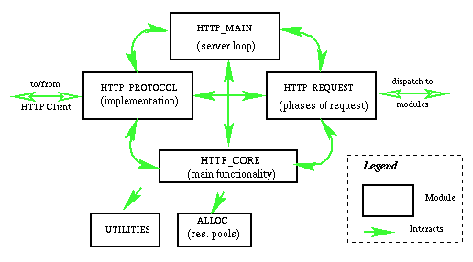
Apache Core
This is what usually occurs in the Apache Core in a sense an overview of the flow that happens in the Apache Core. This is the Apache Core interacting with all the other components that surround it. These are the core components of the Apache architecture. The purpose for this was that the designers wanted to keep every component that didn’t need each other separate so they made them into modules. So this is what was left after everything was left. So this is the Basic “brain” of the Apache Web Server.
The Apache Core is comprised of many different little components that’s handle the Basic implementation of what a web server should be doing.
The core components are a series of classes that handle specific tasks. These should not be confused with modules, which are just add on implementations of different things that Apache can be customized to do. Modules will be explained more in detail in the further slides.

Slide 11
Apache Core Continued…
The Apache Core provides us with the Main functionality of a HTTP web server. Without it or allowing a change to it will remove its modularity, but also remove some of the security. This is why Modules are needed in order to extend the core functionality of Apache.
The core components of make up the Apache core are as follows:
  http_protocol.c: This is the component that handles all of the routines that communicate directly with the client by using the HTTP protocol. This is the component that knows how to also handle the socket connections through which the client connects to the server. All data transfer is done through this component.
  http_main.c: this component is responsible for the startup of the server and contains the main server loop that waits for and accepts connections. It is also in charge of managing timeouts.
  http_request.c: This component handles the flow of request processing, passing control to the modules as needed in the right order. It is also in charge of error handling.
  http_core.c: the component implementing the most basic functionality, it just bairly serves documents.
  alloc.c: the component that takes care of allocating resource pools, and keeping track of them.
  http_config.c : this component provides functions for other utilities, including reading configuration files and managing the information gathered from those files (), as well as support for virtual hosts. An important function of http_config is that it forms the list of modules that will be called to service during different phases of the requests that are going on within the server.

Slide 12
Request Phases
Before we can continue to talk about the Apache Modules we must be able to talk about what are the request phases that are going on within the core. In other words how does Apache know what to do with a request that it received from the client but also what so it does after it has received the request and where does it go from there in order to handle the request that was made to it. This is where request Phases come into play.
Modules due to the architecture of Apache do not know directly know about each other and not one module alone can completely fill or process the request that is made to the Apache server. Most requests are processes by sending the information from one module back to the core then back to another module until the request is completely handled and then it is sent back to the client. Apache has something called Request Phases and is handled by the HTTP_REQUEST component of the core.
The phases or the logic that the HTTP_REQUEST Module of the Apache core controls are as follows:
  URI to filename translation;
  Check access based on host address, and other available information;
  Get an user id from the HTTP request and validate it;
  Authorize the user;
  Determine the MIME type of the requested object (the content type, the encoding and the language);
  Fix-ups (for example replace aliases by the actual path);
  Send the actual data back to the client;
  Log the request;

Slide 13
Overview Of Modules
Modules were made to extend/overwrite and implement the functionality of the Apache web server. However modules do not directly extend each other or “know” directly about each other. So in turn Modules are connected to the Apache core all the same way.
Modules since they do not know directly about each other must pass all in formation back to the core and then the core sends that information to another appropriate module through the use of the HTTP_REQUEST component of the Apache Core. This in turn does not allow any changing of the stable Apache Core, but also implements a layer of security, because no process can move on without passing the in formation to the Core and the core checks and handles errors through the HTTP_REQUEST component.
Apache web server has a modular architecture with a core component that defines the most basic functionality of a web server and a number of modules which implements the steps of processing a HTTP request, offering handlers for one or more of the phases. The core is the one that accepts and manages HTTP connections and calls the handlers in modules in the appropriate order to service the current request by parent and child.
Concurrency exists only between a number of persistent identical processes that service incoming HTTP requests on the same port. Modules are not implemented as separate process although it is possible to fork children or to cooperate with other independent process to handle a phase of processing a request.
The functionality of Apache can be easily changed by writing new modules which complements or replace the existing one. The server is also highly configurable, at different levels and modules can define their own configuration commands.

Slide 14
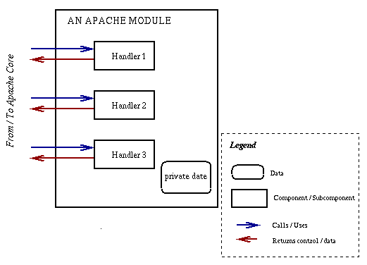
Modules Continued
One cool thing about Apache that makes it robust and allows for better speed is the fact that, Apache allows for initialization of modules Dynamically. So not every module is started when the server starts up which really allows for a giant speed boost.
So what this allows is Apache to only initialize the modules that it needs at that moment. Which allows requests to be processed a lot faster than usual.
Modules have something inside them that are called Handlers.
  Handlers: A handler is for Apache the action that must be performed in some phase of servicing a request. For example a handler that requests a file must open the file then read the file then send it to the Apache core to then be sent to the client. Handlers are defined by the modules depending on when they are needed to fulfill a request then the Handlers are the ones that send back the processing from the Apache Module to the Apache Core HTTP_REQUEST component
Overview of the Handler system within an Apache Module. As you can see the Handler does what it needs to do to fulfill a request then the sends that process back to the HTTP_REQUEST component of the Apache core in order to be sent to another module for processing or back to the client.

Slide 15
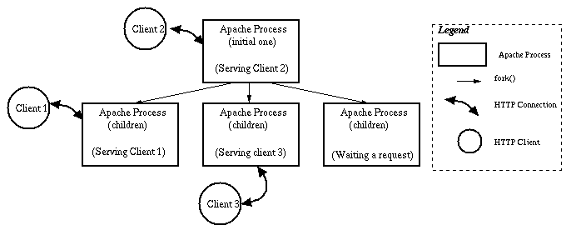
Concurrency in Apache
Apache provides access to two levels of concurrency. The concurrent processes executing truly simultaneously, in the case that they run on separate processors, as in the case of separate processes running on a multitasking system. As well, if multi-threading is supported by the operating system, a default of up to 50 threads is allowed for each process.
Each request that the server receives is actually handled by a copy of the http program. So rather than creating a new instance copy when it is needed, and destroying it when a request is finished, Apache maintains at least 5 and at most 10 inactive children at any given time. The parent process runs a periodic check on a structure called the scoreboard, which keeps track of all existing server processes and their status.
If the scoreboard lists is ever less than the minimum number of idle servers, then the parent will spawn more.
If the scoreboard lists more than the maximum number of idle servers, then the parent will proceed to kill off the extra children.

Slide 16
Concurrency in Apache (contd..)
When it receives a request, the parent process passes it along to the next idle child on the scoreboard. Then the parent goes back to listening for the next request.
When doing the parent and child request there is a limit which by default is set to 256 of the total number request at one time. The default settings was programmed by the creators for the server was to pick in order to keep the scoreboard file small enough so that it can be scanned by the processes without causing overhead concerns.
Since the number of requests that can be processed at any one time is limited by the number of processes that can exist, there is a queue provided for waiting requests. The queue waiting list was mentioned to be when the parent passes a request to a child, which was idle, then the parent returns to receive next request. The maximum number of pending requests that can sit on the queue can reach somewhere in the 400-600.
Apache server architecture was designed to maximize one connection. The uses the persistent connection to allow multiple requests from a client to be handled by one connection, rather than opening and closing a connection for each request. The default maximum number of requests allowed over one connection is 100. The connection is closed by a timeout.

Slide 17
Security Perspective
Another important aspect that is worth discussing is how processes work. Two types of processes are invoked, parent and child. The parent process is the main process from which several child processes are invoked.
Now how does this imply to security right?
Whenever a request is sent to the Apache Web server, the parent process receives the request. Then the parent process forwards the request to one of the child processes. The child process then handles the request by responding to it. This behavior is supported for a valid reason: security.
The root user (SuperUser has all privileges like an Admin) initiates the parent process of the Web server in UNIX systems. The root user, is the most powerful user on the UNIX system. For security reasons, the parent process doesn't directly process the requests sent by the clients.
For example, if a client sends a request with malicious intentions and the parent process handles the request. The parent process will being run as a root user (SupperUser) will have all necessary rights to perform any operation on the computer, thereby making the system server vulnerable. However, if the request is forwarded to a process that has restricted permissions on the computer, no harm can be done which is handled in the child process. This is because child processes are run as users with restricted privileges.

Slide 18
Apache Installation
Download the source files from Apache site http://httpd.apache.org/download.cgi
Extract the Apache Files, this creates a new directory under the current directory with the source files.
gunzip -d httpd-2_0_NN.tar.gz
tar xvf httpd-2_0_NN.tar
To build Apache from source and install it with the default settings requires only three commands:
one to configure it
one to build it and
one to install it.

Slide 19
Apache Installation (contd..)
The following command scans the server to find out what capabilities the operating system has (or lacks), determines the best way to build Apache, and sets up the source tree to compile based on this information:
$ ./configure
The remainder of the configuration process is concerned with taking your customizations, supplied as command line options, and reconfiguring the source code accordingly. This allows you to enable or disable features, include additional components, or override default server locations and limits. For a list of all available options, you can instead use this:
$ ./configure –help http://httpd.apache.org/docs/2.2/programs/configure.html
Once the Apache source is configured, you need to build and install it. The following commands build Apache and then install it in the default location of /usr/local/apache
$ make
$ make install
You can have Apache install into a different location by supplying a parameter to the configure command. For example:
$ ./configure --prefix=/opt/apache2

Slide 20
Apache Installation (contd..)
-l ➔ Lists compiled-in modules
-V➔ Shows version number and configuration at server compilation time
-f ➔ Allows you to pass the location of httpd.conf if it is different from the compile-time default
-h ➔ Lists complete list of command line options
-M ➔ Display both static and dynamic module loaded by Apache
-L ➔ Show all accepted directives inside httpd.conf
-k ➔ Validate the httpd.conf after making changes
http://www.thegeekstuff.com/2008/08/9-tips-to-use-apachectl-and-httpd-like-a-power-user/

Slide 21
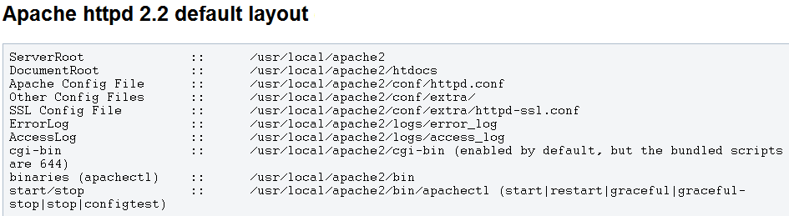
Directory Structure

Slide 22
Directory Structure (contd..)
Apache can be installed on a variety of operating systems will typically have four main directories: htdocs, conf, logs, bin
htdocs is the default document directory, meaning it is the public directory whose contents are usually available for clients connecting through the web. It contains all static pages and dynamic content to be served once an HTTP request for them is received. Since files and sub-directories under htdocs are available to the public, correct handling of file permissions is of great importance so as not to compromise the server’s safety and security.
conf is the directory where all server configuration files are located. Configuration files are basically plain text files where directives are added to control the web server’s behavior and functionality. Each directive is usually placed on a separate line, and the hash (#) key indicates a comment so the line proceeded by it is ignored.
logs is the directory where server logs are kept, and includes Apache access logs and error logs. The Apache HTTP Server provides a variety of different mechanisms for logging everything that happens on it, from the initial request, through the URL mapping process, to the final resolution of the connection, including any errors that may have occurred in the process.
Bin Contains executable binaries

Slide 23
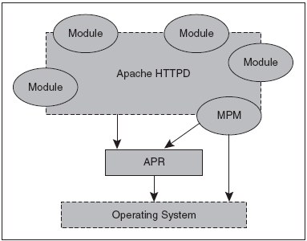
Server Startup
The server relies on the Apache Portable Runtime (APR) libraries, which provide a cross-platform operating system layer and utilities, so that modules don’t have to rely on non-portable operating system calls.
A special-purpose module, the Multi-Processing Module (MPM), serves to optimize Apache for the underlying operating system. The MPM should normally be the only module to access the operating system other than through the APR.

Slide 24
Server Startup (contd..)
If you make some changes to the configuration files and you want them to take effect, you must signal Apache that the configuration has changed. You can do this by stopping and starting the server or by sending a restart signal. This tells Apache to reread its configuration.
A normal restart can result in a momentary pause in service. A graceful restart takes a different approach. Each thread or process serving a client will keep processing the current request, but when it is finished, it will be killed and replaced by a new thread or process with the new configuration. This allows seamless operation of the Web server with no downtime.
Start, Stop or Restart HTTPD:
sudo /usr/local/webs/apache-2.2.22/bin/httpd -k stop
sudo /usr/local/webs/apache-2.2.22/bin/httpd -k start
sudo /usr/local/webs/apache-2.2.22/bin/httpd -k restart
sudo /usr/local/webs/apache-2.2.22/bin/httpd -k graceful
To enable auto start apache during boot time, you need to do some configuration on /etc/rc.d/init.d directory.
http://www.techiecorner.com/104/how-to-auto-start-apache-during-boot-time-linux/

Slide 25
Server Startup (contd..)
Apache operation proceeds in two phases: start-up and operational.
Start-Up:
System start-up takes place as root, and includes parsing the configuration file's, loading modules, and initializing system resources such as log files, shared memory segments, and database connections.
Each module may have its own resources, and has the opportunity to initialize those resources. At start-up, Apache runs as a single-process, single-thread program and has full system privileges.
If the Listen specified in the configuration file is default of 80 (or any other port below 1024), then it is necessary to have root privileges in order to start apache, so that it can bind to this privileged port.
Operational:
The second pass is “live” and leads into the operational phase.
Once the server has started and performed a few preliminary activities such as opening its log files, it will launch several child processes which do the work of listening for and answering requests from clients. This is controlled by the selected Multi-Processing Module.

Slide 26

Apache Configuration
The Apache HTTP Server configuration file is /etc/httpd/conf/httpd.conf. The httpd.conf file is well-commented and mostly self-explanatory. The default configuration works for most situations; however, it is a good idea to become familiar some of the more important configuration options.
Configuration Directives in httpd.conf

